Slide 1
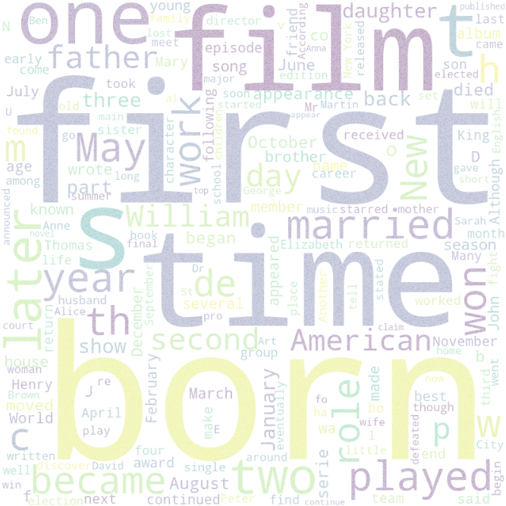
GENDERED PRONOUN RESOLUTION WITH BERT
Swaroop Meher

Slide 2
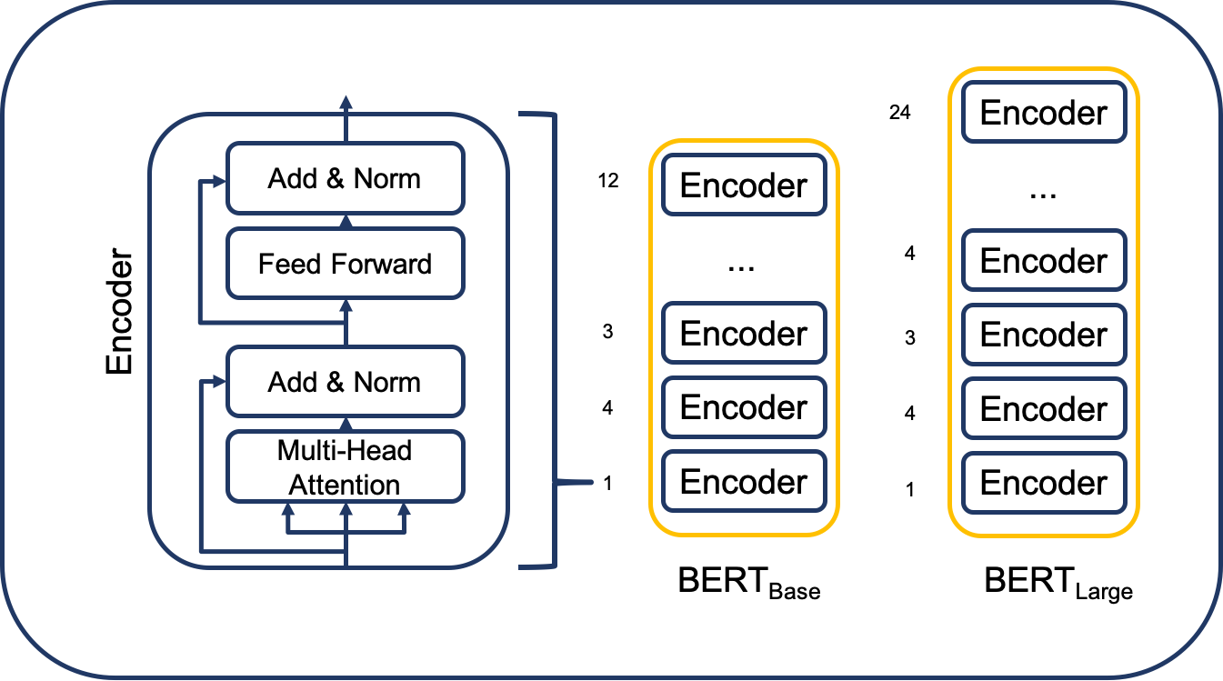
Agenda
Introduction
DATASET
Primary goal
PROPOSED SOLUTION
results
Areas of growth
Summary

Slide 3
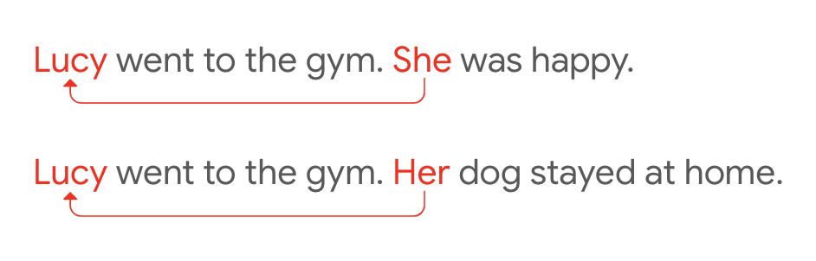
Introduction
Pronoun resolution is part of coreference resolution, the task of pairing an expression to its referring entity.
Resolution of ambiguous pronouns is a longstanding challenge.
Researchers have also found out that SOTA contain gender-bias.

Slide 4
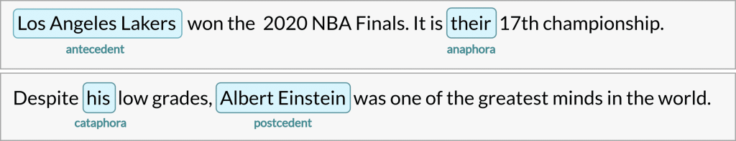
COREFERENCE RESOLUTION
https://neurosys.com/blog/intro-to-coreference-resolution-in-nlp

Slide 5

AMBIGUOUS PRONOUN
https://www.microsoft.com/en-us/research/blog/the-knowref-coreference-corpus-a-resource-for-training-and-evaluating-common-sense-in-ai/

Slide 6
DATASET
Google AI Language aims to improve gender-fairness in modeling by releasing the Gendered Ambiguous Pronouns (GAP) dataset.
Gender-balanced pronouns (50% of its examples containing feminine pronouns, and 50% containing masculine pronouns).
ID | Text | Pronoun | Pronoun-offset | A | A-offset | A-coref | B | B-offset | B-coref
development-1 | … | her | 274 | Cheryl Cassidy | 191 | TRUE | Pauline | 207 | FALSE
validation-1
test-1
https://github.com/google-research-datasets/gap-coreference

Slide 7
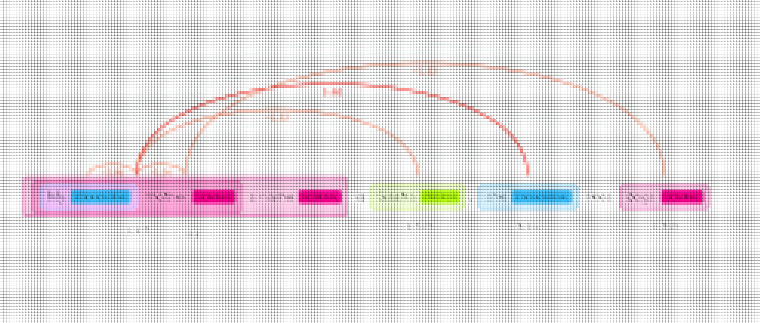
Primary goal
JUST RESOLVE IT

Slide 8
Take this data and classify to one of the three classes A, B, and Neither.
A
DATA
PRE-PROCESS
MODEL
Neither
B

Slide 9
PROPOSED SOLUTION
Preprocess the data
Remove abbreviation periods.
Split the text into sentences
Use a pretrained model to gather the contextual embeddings of the nouns and pronoun we need.
Pass these embeddings to a feed forward fully connected neural network.
Train it on train dataset along with hyperparameter tuning. Evaluate using validation dataset.
Predict the right class for the given text, nouns and pronoun in the test dataset

Slide 10
PROPOSED SOLUTION
Data
Peter didn’t realize how old Henry was until he saw his daughter.
Labels
Henry
Pre-process
Feed-Forward Neural Network
BERT
Layer 9 of pretrained bert_en_uncased_L-12_H-768_A-12
(3, 768)

Slide 11
PREPROCESSING
Peter didn’t realize how old Henry was until he saw his daughter.
Peter
Remove Abbreviation Periods
BERT
Henry
Tokenize
Layer 9 of pretrained bert_en_uncased_L-12_H-768_A-12
(n, 256, 768)
(s_id, w_id, 768)
Find the position w_id of the word in the sentence s_id
his
bert_en_uncased_preprocess
(3, 768)

Slide 12
NEURAL NETWORK
Peter
Trained with 2000 samples
Validated with 454 samples
Tested with 2000 samples
Feed-Forward Neural Network
Henry
Henry
4 Dense Layers
with Dropout
his
(3, 768)

Slide 13
RESULTS
With embeddings used from Layer 12, test accuracy was 69%.
With embeddings used from Layer 9, test accuracy was 74.65%.
With embeddings used from Layer 9 and 5-fold Cross validation, ensemble test accuracy was 43%.
https://aclanthology.org/W19-3815.pdf

Slide 14
Areas of GROWTH
Use bert large
Ensemble learning
Collect more data
Use methods like
Handcrafted features
Projection
IMPROVE ABILITY TO HANDLE LONGER TEXTS

Slide 15
Summary
In summary, the method involves the utilization of the powerful BERT base pre-trained network to extract contextual embeddings of pertinent words in a given text in order to accurately map pronouns to their corresponding nouns. Our results have shown a accuracy of 75% through this efficient approach. However, we posit that with further refinement and augmentation, we can attain an even more impressive accuracy of approximately 90%.

Slide 16
Thank you
Swaroop Meher
swaroopm@bu.edu | linkedin.com/in/swaroop-meher

